Slide 1
Project 7 MLOps and DataOps
By
Rizky Romadhon

Slide 2
Table of contents
01
About Project
03
Write a Code
02
Preparation
04
Conclution
Study case, expect area project
Create Code to new project
Install some library to start a new project
Feedback about this project

Slide 3
01
About Project

Slide 4
About Project?
Study Case
Expected outcome
Assessment Point
From DS team need help DE team for develop machine learning project about health insurance prediction. We have already model, please implement our model and deploy into API so that SE team can use this model in our product.
Develop script API using Flask, Can predict data using API and documentation for this project
Build API service using Flask for implement ML model

Slide 5
02
Preparation

Slide 6



Preparation Tools
Python
Docker
VSCode

Slide 7
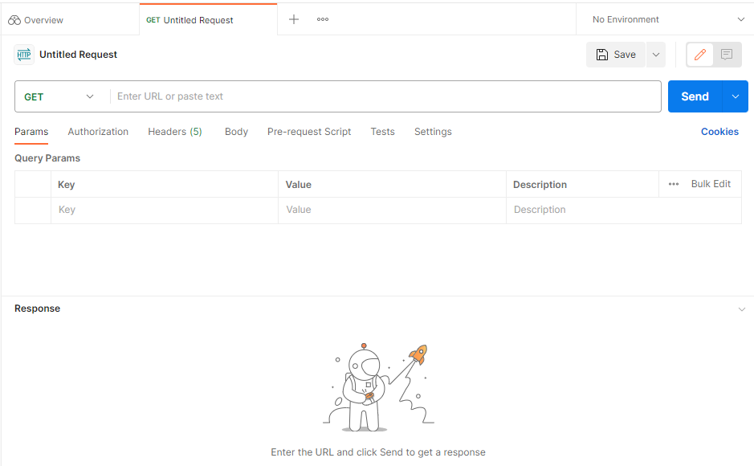
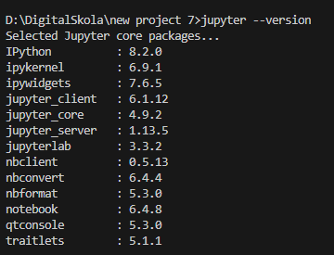
Preparation Tools
Postman (Desktop Version)
Jupyter Notebook

Slide 8
Preparation Data
Download script modeling ML
Link: https://drive.google.com/drive/folders/1UKRWdWw_tBsRW_QiCT2ZcAlFR-Q128RY?usp=sharing

Slide 9
03
Write a Code

Slide 10

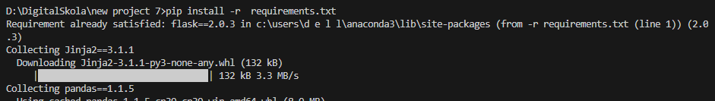
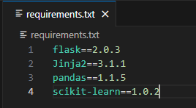
Build Flask API
Create Requirements.txt
Install requirement package python
Open Requirements.txt and write list package Python

Slide 11

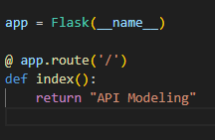

Build Flask API
Create main.py for Flask main file
Create a route for first testing API
Open main.py and import library for Flask

Slide 12
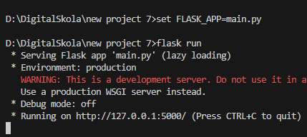
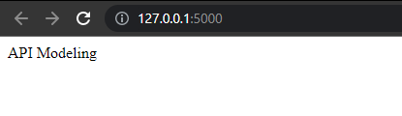
Build Flask API
Set main.py to Flask App and run Flask API. click the link (IP localhost) for directions to the local page
And Flask API is running. If Flask API doesn’t run you need to check your main.py

Slide 13
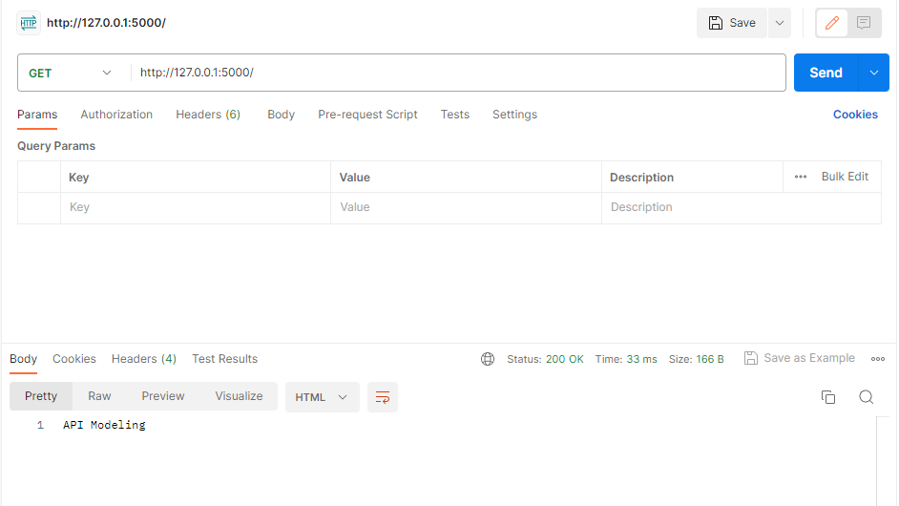
Build Flask API
And also when we try on Postman, API still runs too. And for the Flask API was done.

Slide 14
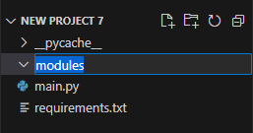
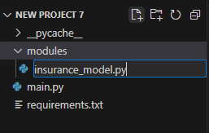
Implement ML Model
Create a folder for saving ML model
Create insurance_model.py in modules folder

Slide 15
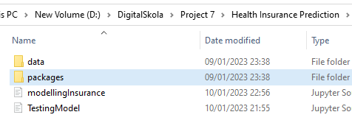
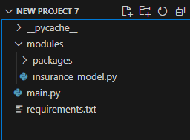
Implement ML Model
Before the next step, we need to move an ML model that we download for the link. And we can move to folder modules who we create before

Slide 16
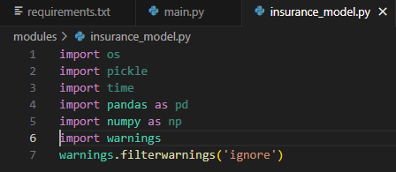

Implement ML Model
After that, Import modules for implementing the ML Model in the insurance_model.py file
Create class “InsuranceModel” in the insurance_model.py file

Slide 17
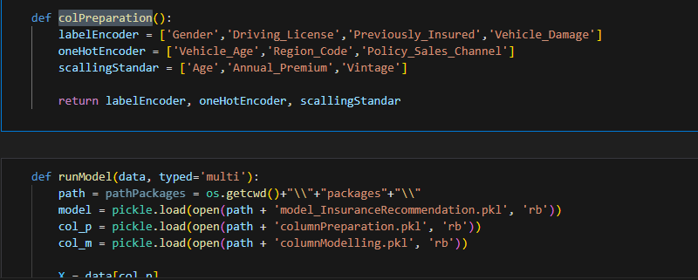
Implement ML Model
After that, we copy the function in "TestingModel.ipynb“ (we got this file from the link) and then we can copy 2 functions to implement a ML model (we put “colPreparation” and “runModel”) and we put this function on a new class “InsuranceModel”

Slide 18
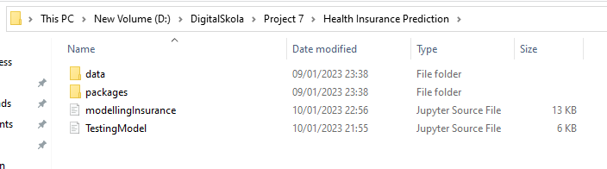
Implement ML Model
After that, we copy the function in "TestingModel.ipynb“ (we got this file from the link) and then we can copy 2 functions to implement a ML model (we put “colPreparation” and “runModel”) and we put this function on a new class “InsuranceModel”

Slide 19
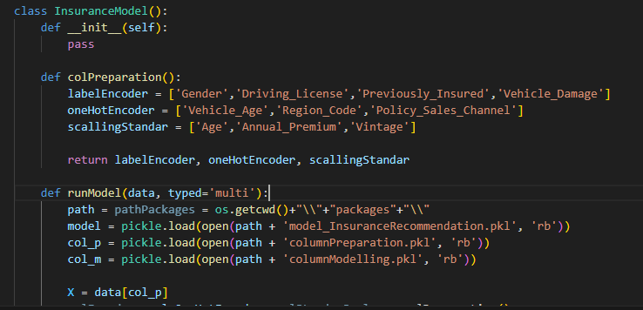
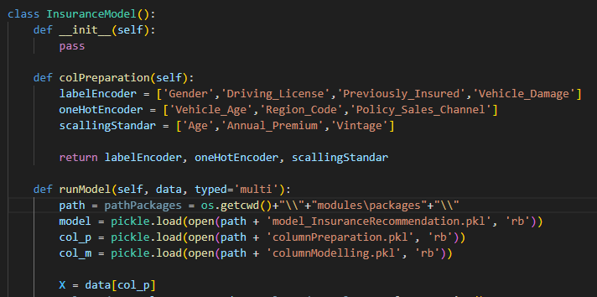
Implement ML Model
And then we can call “self” in our function and change some directories on the path variable. Because we put the packages on modules.
before
after

Slide 20
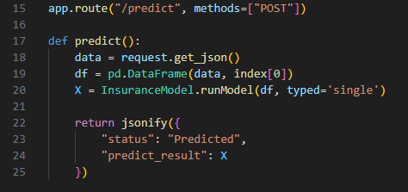
Implement ML Model
And then, go to main.py, we want to set a parameter for calling a model. First import module to read data in pandas and import “insuranceModel” to read an ML model
Add a new route for the machine learning model endpoint in "main.py"

Slide 21
Implement ML Model
Set main.py to Flask App and run Flask API. click the link (IP localhost) for directions to the local page
And Flask API is running. If Flask API doesn’t run you need to check your main.py

Slide 22
Implement ML Model
Set main.py to Flask App and run Flask API. click the link (IP localhost) for directions to the local page
And Flask API is running. If Flask API doesn’t run you need to check your main.py

Slide 23
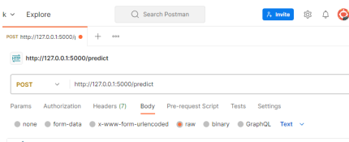
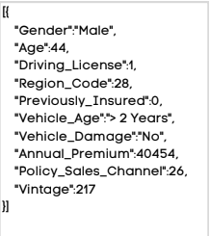
Implement ML Model
And also when we want to test Postman, first put JSON on body->raw. And then write sample a JSON to get a response.
Put JSON on Box

Slide 24
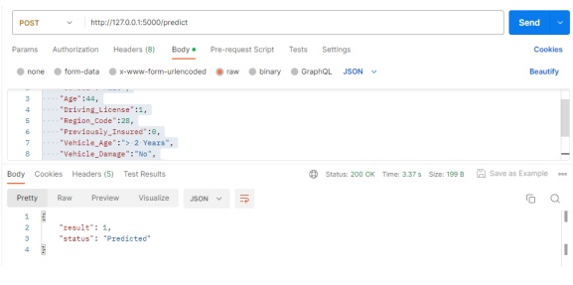
Implement ML Model
Finally Postman will be give response from our API

Slide 25
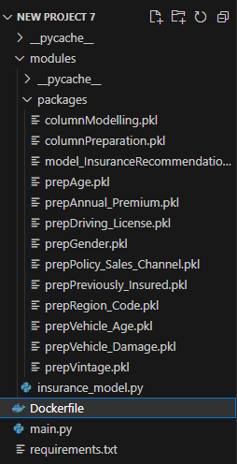
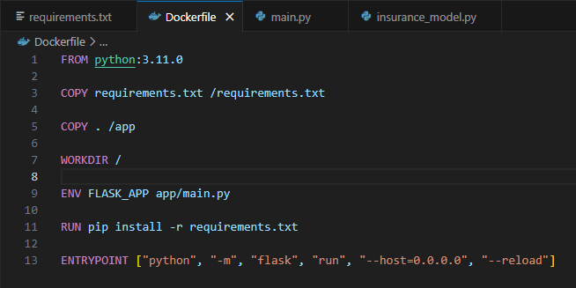
Create Docker & Docker Compose
Create a file “dockerfile” and write the file with this code to make FLASK API run.

Slide 26
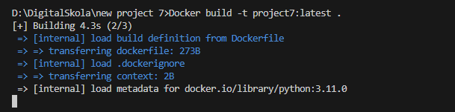
Create Docker & Docker Compose
Build Docker to create a Docker image

Slide 27

Create Docker & Docker Compose
After that in Model_insurance.py, we modify the path variable to make docker read our data. You can adjust base your file saved

Slide 28
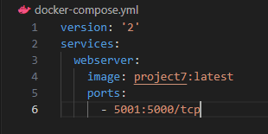
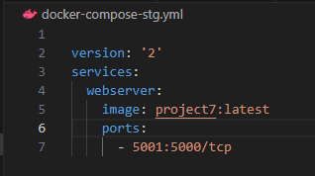

Create Docker & Docker Compose
And then you can create .yml file for production and staging. And start your docker with comment below:

Slide 29
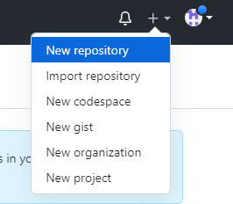
Push to GitHub
Sign in to GitHub
Create New Repository

Slide 30
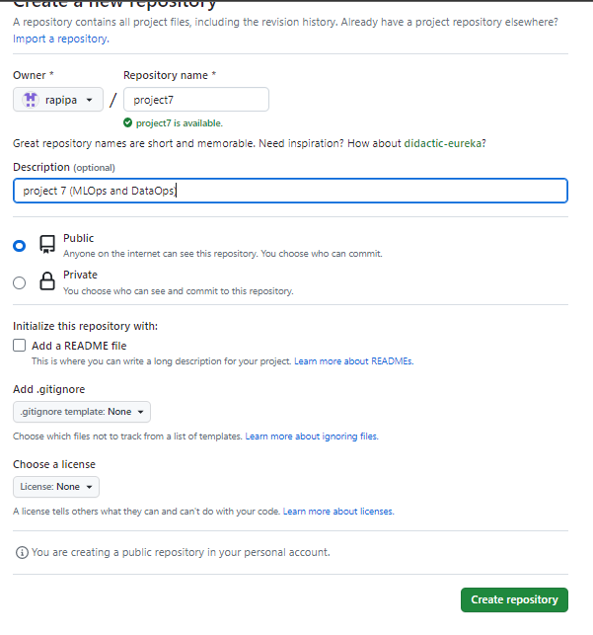
Push to GitHub
Fill in the named repository and then click Create repository

Slide 31
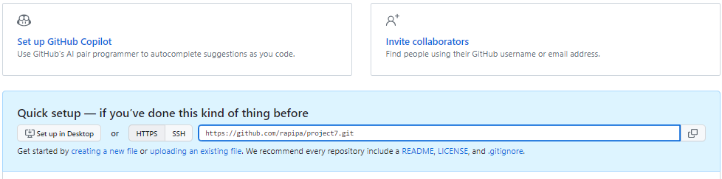
Push to GitHub
Copy the URL and we start copying our repo to local with GitBash

Slide 32
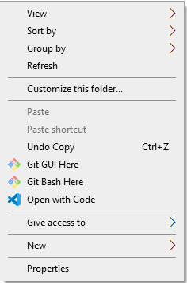
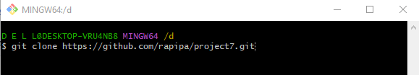
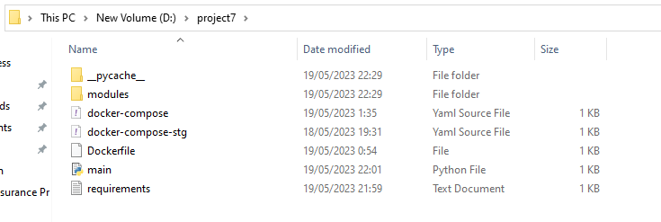
Push to GitHub
Open your GitBash and clone the repo in our local. And then copy our code to the repository folder

Slide 33
Push to GitHub
Open your GitBash and clone the repo in our local. And then copy our code to the repository folder

Slide 34

Push to GitHub
Create new branch to upload a file

Slide 35


Push to GitHub
Install git-lfs on https://git-lfs.com/ to upload more than 100 MB. And define on GitBash. And track files that have size of more than 100 MB

Slide 36


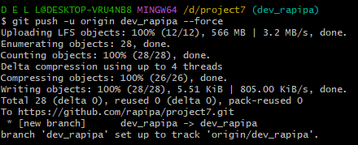
Push to GitHub
Add, commit, and push the file with the code like this:

Slide 37
Push to GitHub
Add, commit, and push the file with the code like this:

Slide 38
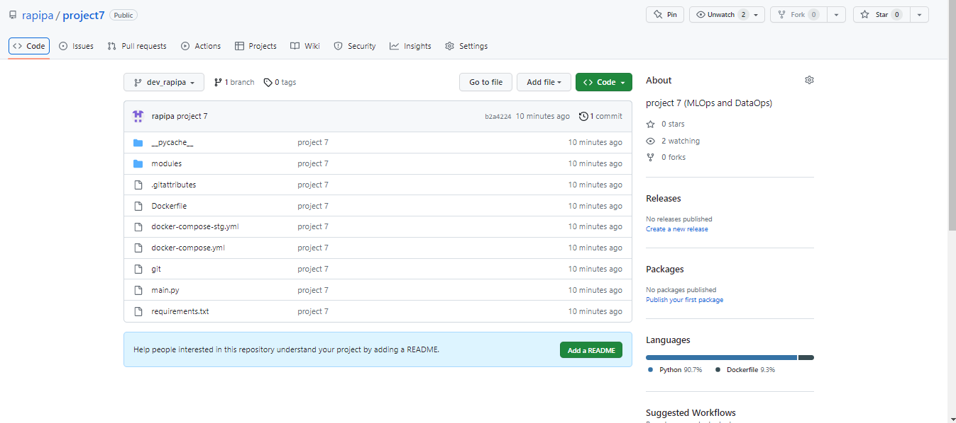
Push to GitHub
Finally, the file already push on GitHub

Slide 39
04
Conclution

Slide 40
This project is good for me because I learn a lot from this project. So I want to create more project with knowledge from DigitalSkola

Slide 41
Thanks!
Does anyone have any questions?
addyouremail@freepik.com
+91 620 421 838
yourcompany.com
Please keep this slide as attribution

